Slide 1
FIND 1
Discovering Data
Dr Liz Hind

Slide 2
Welcome
Local Data Project
At the end of this session you will be able to access a public data source and assess its use for equalities work
We will cover:
Introduction to data
The data cycle
What data can (and can’t) do
Assessing a data source

Slide 3
WISDOM
KNOWLEDGE
INFORMATION
DATA

Slide 4
Illustration adapted by David Somerville from the original by Hugh MacLeod

Slide 5
Problem
Understand
Define
How do we answer?
Conclusion
Plan
Communication
Conclusions
Gaps
What to measure
How to measure
Analysis
Data
Sort
Charts
Patterns
Collection
Management
Cleaning

Slide 6
If you don’t understand the situation - then you can’t analyse the data

Slide 7
Discussion time
Do A Level choices have an impact on Women’s economic equality?

Slide 8
A Level Choices
Go to https://ifs.org.uk/publications/15261
Economics is dominated by men. Unless more girls are offered A level economics at school, this will not change.
Notes:
https://ifs.org.uk/publications/15261

Slide 9
Common Pitfalls
Correlation does not mean causation

Slide 10
Common Pitfalls
Don’t mix the measures!
Mr Shapps went on to say: "The median salary for the rail sector is £44,000, which is significantly above the median salary in the country."
We asked the Department for Transport (DfT) how it got to this figure and it initially said it had taken the median figures from the ONS for four categories of workers, added them up and divided by four:
Rail travel assistants - £33,310 - includes ticket collectors, guards and information staff
Rail construction and maintenance operatives - £34,998 - they lay and repair tracks
Rail transport operatives - £48,750 - includes signallers and drivers' assistants
Train and tram drivers - £59,189
https://www.bbc.co.uk/news/61840077
BBC News 21/06/2022
Notes:
https://www.bbc.co.uk/news/61840077

Slide 11
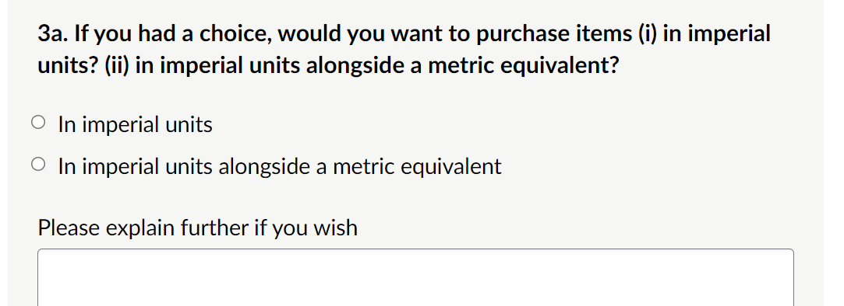
Common Pitfalls
Bad Data Collection

Slide 12
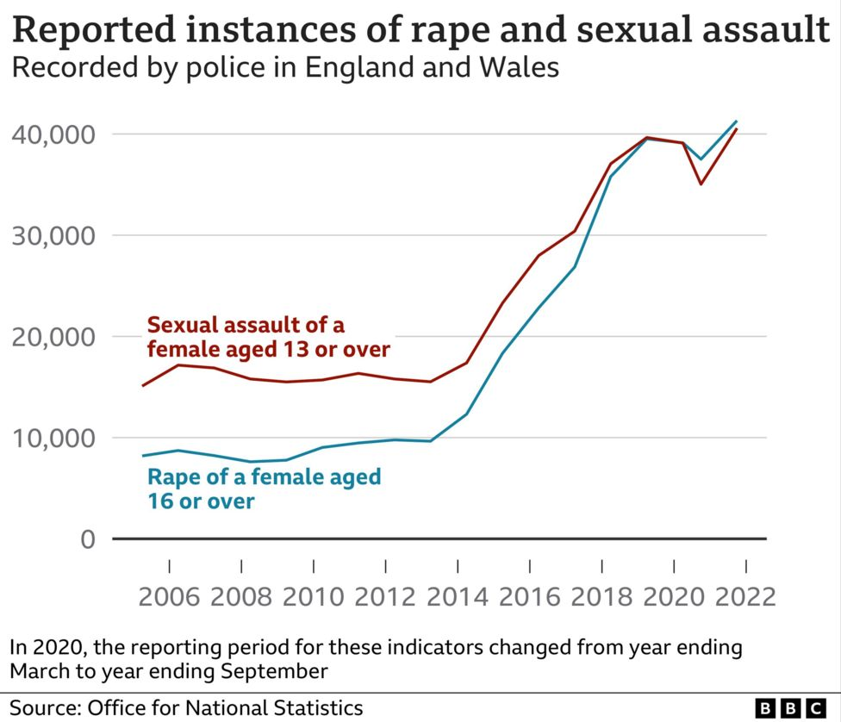
Common Pitfalls
Problems collecting

Slide 13
Evaluating a Data Source
•Who collected the data?
•When was it collected
•Why?
•Sample/Population?
•What?
•Aggregation
•How does it relate to equality

Slide 14
Exercise Time
Need three groups
We will assign you to break out rooms
Each will look at a data source and evaluate it.
1 - Police - www.police.uk
2 - Indices of Multiple Deprivation - https://mapmaker.cdrc.ac.uk/#/index-of-multiple-deprivation?m=imde19_rk&lon=-1.5624&lat=51.5302&zoom=7.9
3 - Charity Grants - https://grantnav.threesixtygiving.org/
Notes:
Police - www.police.uk
IMD - https://mapmaker.cdrc.ac.uk/#/index-of-multiple-deprivation?m=imde19_rk&lon=-1.5624&lat=51.5302&zoom=7.9
Charity Grants - https://grantnav.threesixtygiving.org/

Slide 15
Review
At the end of this session you will be able to access a public data source and assess its use for equalities work
What data is
Importance for equalities work
Data cycle
Common pitfalls
Evaluate a source

Slide 16
Next Session
Delving into Data
Data from the ONS
Common statistical measures
Data on cost of living crisis

Slide 17
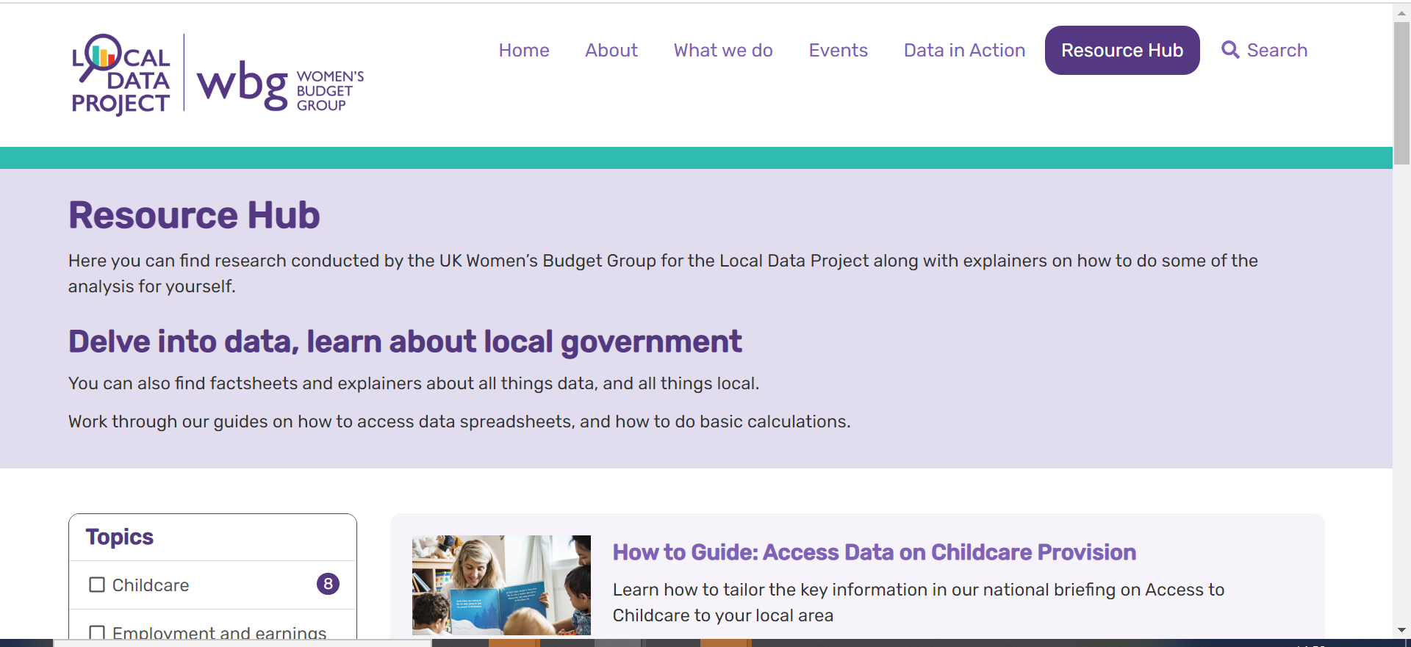
Local Data Project Resources
Notes:
https://www.wbg-localdata.org.uk/

Slide 18
FIND 2
Delving Into Data
Dr Liz Hind

Slide 19
Welcome
Local Data Project
At the end of this session you will be able to access official statistics from the ONS and use it to comment on the cost of living crisis
We will cover:
Who collects data
What is inflation and how is it measured
Where to access pay data

Slide 20
Government Departments
Business, Energy and Industrial Strategy
Department of Environment, Food and Rural Affairs
Home Office
Department for Transport
Department Work and Pensions
Organisation for Economic Cooperation and Development

Slide 21
Academics and Agencies
NHS
Police
Fire Brigade
International Monetary Fund
National Centre for Social Research
Universities
Citizens Advice
Think tanks

Slide 22
Office for National Statistics
UK’s largest independent producer of official statistics
the recognised national statistical institute of the UK
ONS produces of a wide range of statistics covering the UK economy, society and other key areas such as:
Crime and migration
UK population and demography,environmental issues
Tourism
Societal well-being
Fire and rescue services

Slide 23
Problem
Understand
Define
How do we answer?
Conclusion
Plan
Communication
Conclusions
Gaps
What to measure
How to measure
Analysis
Data
Sort
Charts
Patterns
Collection
Management
Cleaning

Slide 24
Cost of Living Crisis
Stagnating Incomes
Inflation
Will be felt by different groups differently

Slide 25
What is your personal inflation rate?
https://www.ons.gov.uk/economy/inflationandpriceindices/articles/howisinflationaffectingyourhouseholdcosts/2022-03-23
Work through the calculator. If you’re not sure about your own figure then use the national average figure.
Note - when you click on next it may not be obvious that the page has changed
Notes:
https://www.ons.gov.uk/economy/inflationandpriceindices/articles/howisinflationaffectingyourhouseholdcosts/2022-03-23

Slide 26
Price Indexes
RPI - Retail Price Index – No longer a national statistic. It tracks the price of a set basket of goods. It is still published to give comparable historical data. Still used by the treasury for various index-linked tax rises. Higher than the CPI. Calculated using an arithmetic mean
CPI - Consumer Price Index - The CPI. The Consumer Price Index (CPI) is calculated by tracking the price movements of 650 items, which represents a basket of goods and services typically bought by the 'average' UK households. Uses the geometric mean.
CPIH - Consumer Price Index including Housing - It extends CPI to include a measure of the costs associated with owning, maintaining and living in one's own home, known as owner occupiers' housing costs (OOH), along with council tax.
https://www.ons.gov.uk/economy/inflationandpriceindices/datasets/consumerpriceinflation
Notes:
https://www.ons.gov.uk/economy/inflationandpriceindices/datasets/consumerpriceinflation

Slide 27
Housing Costs
Private Rental costs in England
https://www.ons.gov.uk/peoplepopulationandcommunity/housing/datasets/privaterentalmarketsummarystatisticsinengland
Notes:
https://www.ons.gov.uk/peoplepopulationandcommunity/housing/datasets/privaterentalmarketsummarystatisticsinengland

Slide 28
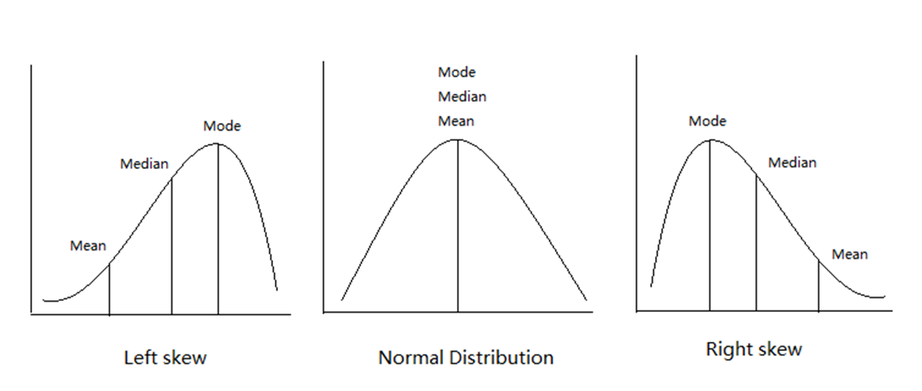
Mean, Mode or Median

Slide 29
Stagnating Earnings
https://www.ons.gov.uk/employmentandlabourmarket/peopleinwork/earningsandworkinghours/bulletins/annualsurveyofhoursandearnings/2021
Home Parliamentary Constituency Table 10.6a Hourly pay - Excluding overtime 2021
Notes:
AHSE:
https://www.ons.gov.uk/employmentandlabourmarket/peopleinwork/earningsandworkinghours/bulletins/annualsurveyofhoursandearnings/2021

Slide 31
Review
At the end of this session you will be able to access official statistics from the ONS and use it to comment on the cost of living crisis
There is a lot of official data produced and published through the ONS
The ONS summarises data as a statistical bulletin
But
Large data sets
Unwieldy tables
Difficult to find just the bit you want

Slide 32
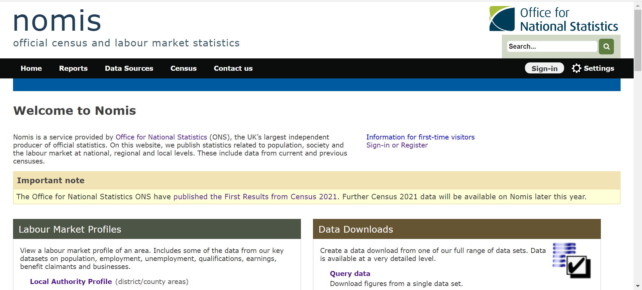
Next Session
Get smarter with your data
Access just the bit you want
Notes:
https://www.wbg-localdata.org.uk/
https://tinyurl.com/33ma7up2

Slide 33
FIND 3
Using Nomis
Dr Liz Hind

Slide 34
Welcome
Local Data Project
At the end of this session you will be able to create a custom query in nomis to download data that is relevant to your area
We will cover:
What is nomis
Using local reports
Simple filers and reformatting
Custom queries

Slide 35
What is nomis?
Run by the ONS
Statistics related to population, society and the labour market at national, regional and local levels.
Allows for custom queries and manageable slices of data
Also provides information on datasets and releases
Free to access, Registration allows saving of queries and access to the Business Register and Employment Survey
https://www.nomisweb.co.uk/
Notes:
https://www.nomisweb.co.uk/

Slide 36
Review
At the end of this session you will be able to create a custom query in nomis to download data that is relevant to your area

Slide 37
FIND Training
Discovering data
What is data
What can it do
What are its limitations
Why is it needed in campaigns
Delving into data
Who collects data and possible biases/omissions
Using the ONS website
Measuring inflation, income and gender pay gaps

Slide 38
Problem
Understand
Define
How do we answer?
Conclusion
Plan
Communication
Conclusions
Gaps
What to measure
How to measure
Analysis
Data
Sort
Charts
Patterns
Collection
Management
Cleaning

Slide 39
Going Further
How are you going to use what you have learned?
Campaign
Produce a briefing
Write a report
Social media

Slide 40
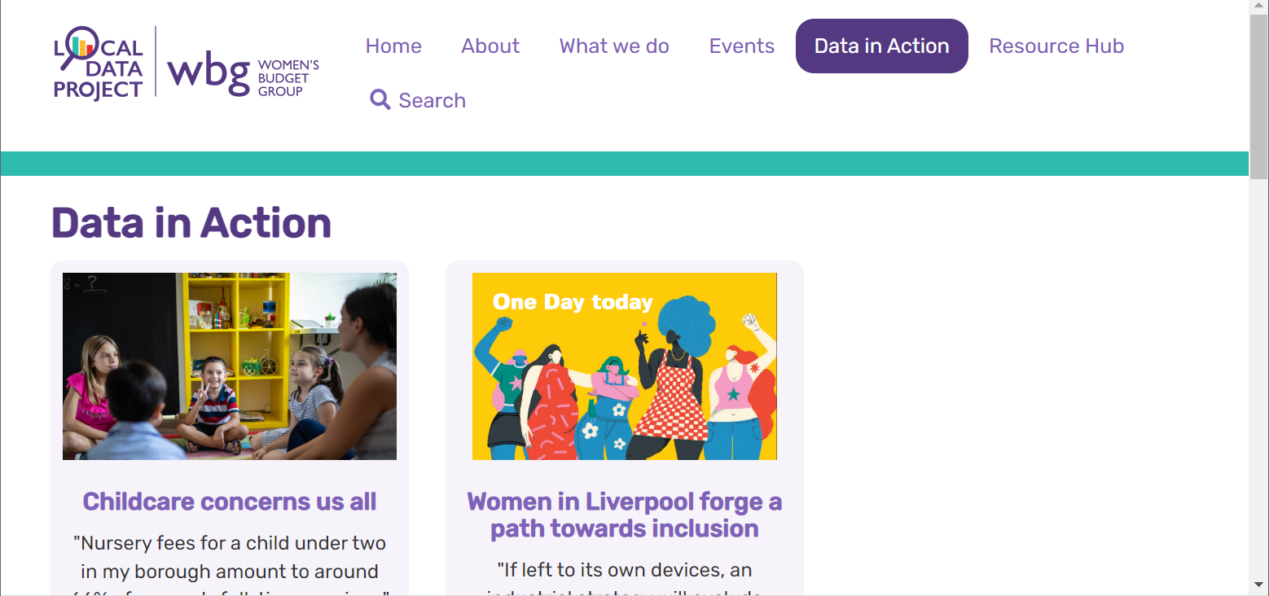
Tell us what you do!
Add your work to our webpage
Notes:
https://www.wbg-localdata.org.uk/data-in-action/

